Slide 1
City of Ottawa - New Fox River (2nd) Wastewater Treatment Plant, Pump Station, Sewers, and Forcemain (FGA#21-611)
IEPA Preliminary Environmental Impacts Determination (PEID) Public Meeting (IEPA#L17-6297) - July 18, 2023 @ 5:30 pm, Ottawa City Hall
Presenter:
Narendra Patel, PE, PMP®, Project Manager
Illinois PE#062-60002, PMP#3363551
Fehr Graham – Champaign, Illinois

Slide 2
Key Highlights
NPDES permitting and Engineering Report (January 2022)
IEPA Facility Planning Report (August 2022) – Planning highlights and new WWTP process flow diagram
NPDES permitting status (March 2023 – June 2023)
Fox River Study Group engagement and support
IEPA’s 10-day internal review draft
IEPA’s 30-day public notice public comment copy
Final NPDES permit status
IEPA Facility Planning – Preliminary Environmental Impact Determination (PEID) approval summary (May 2023)
Planned schedule and next steps into project…
Questions/Comments

Slide 3
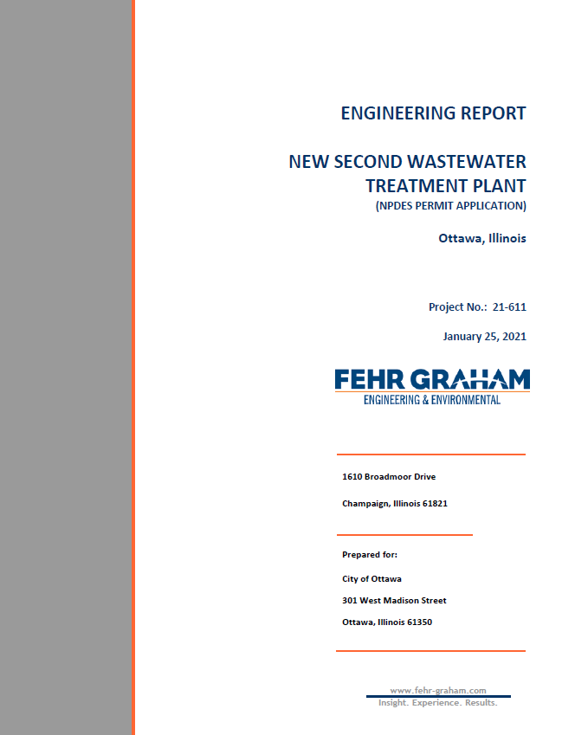
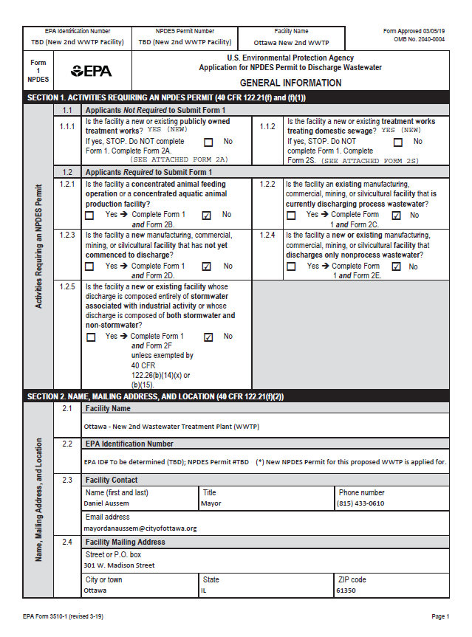
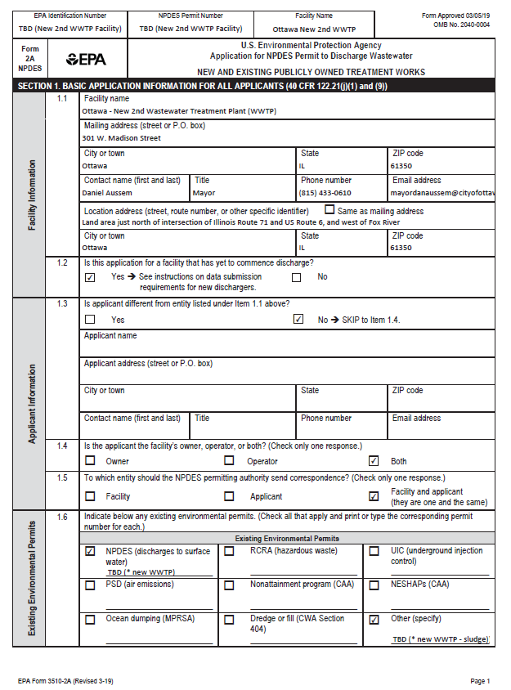
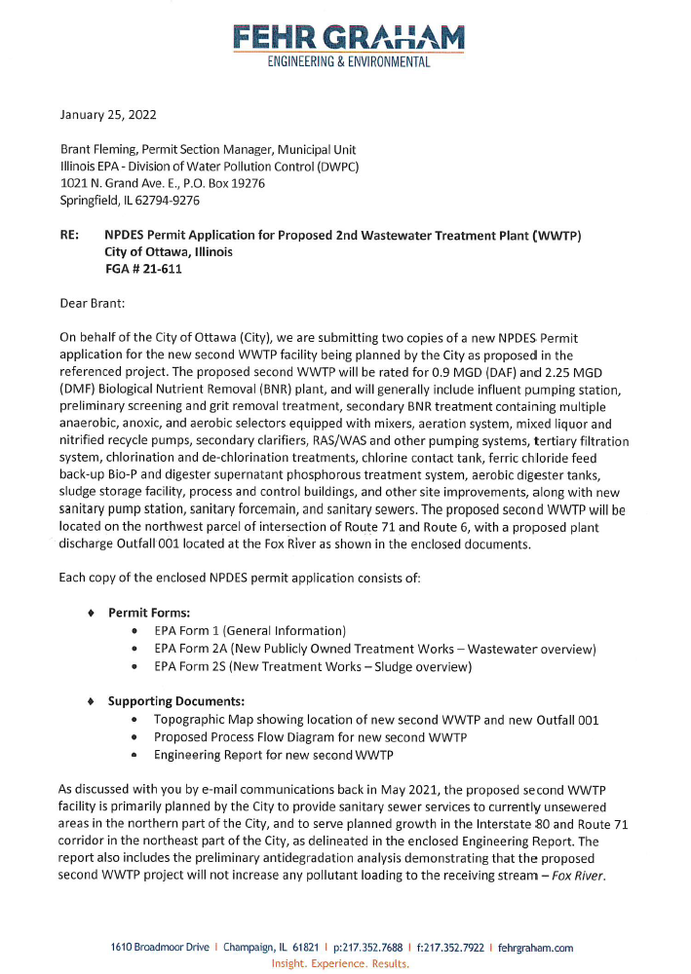
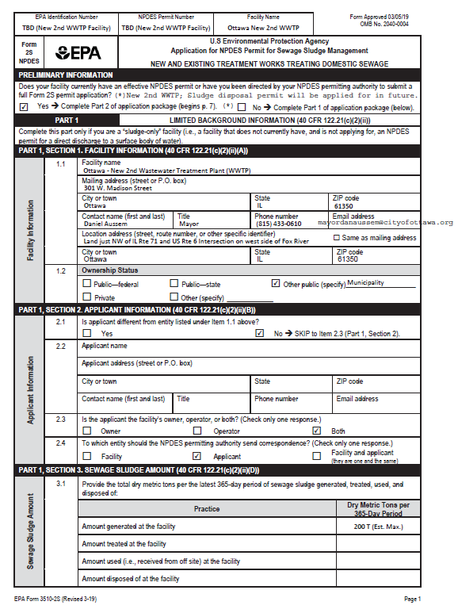
NPDES Permitting & Engineering Report
NPDES Permit Forms
NPDES Engineering Report

Slide 4
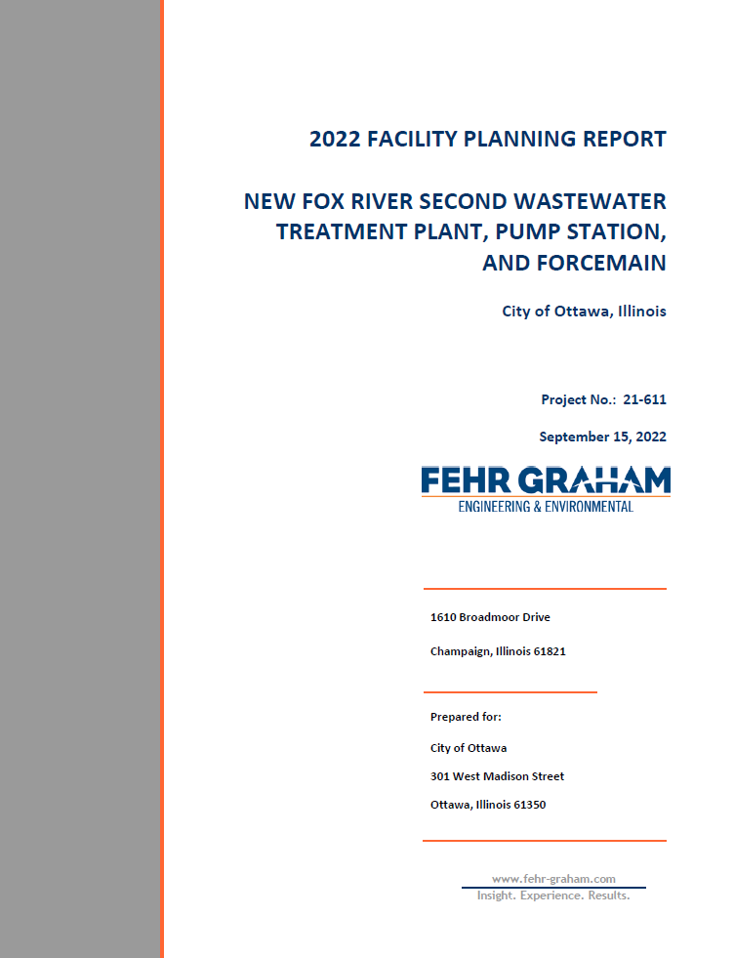
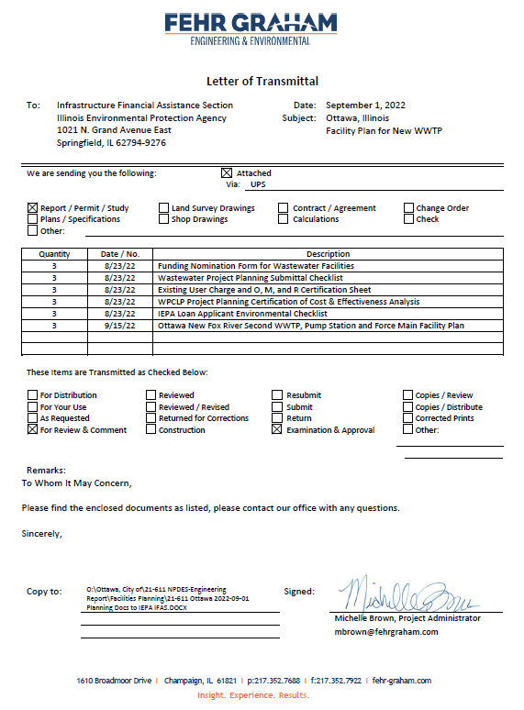
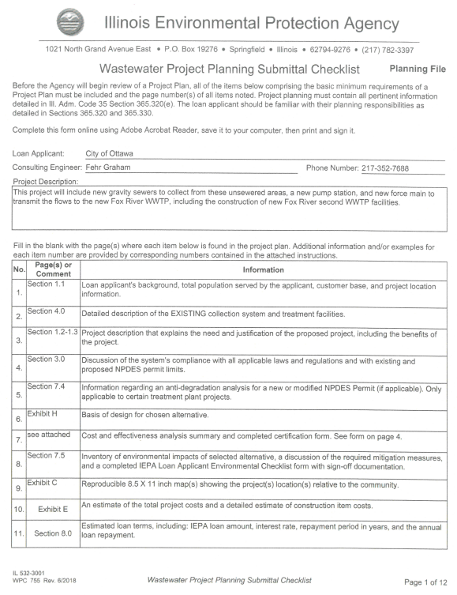
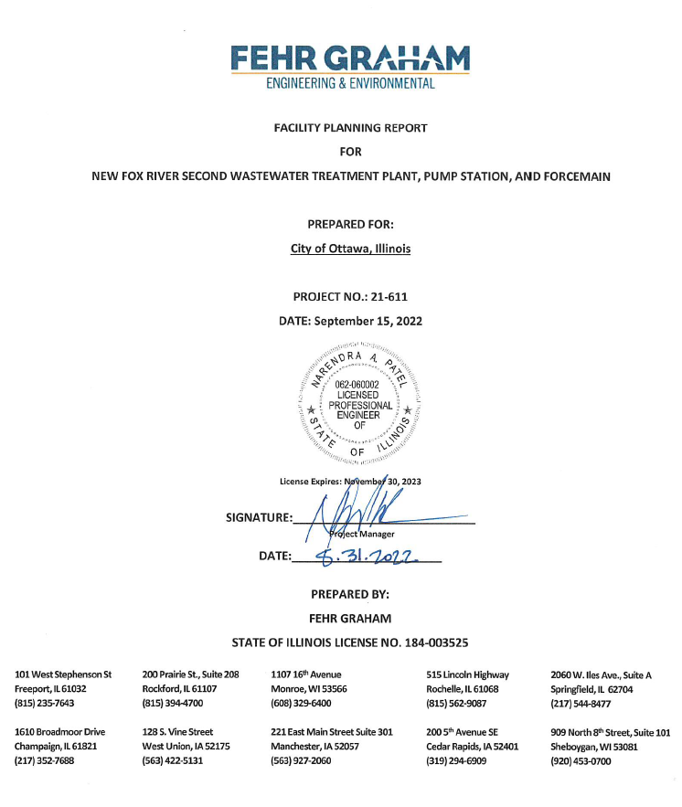
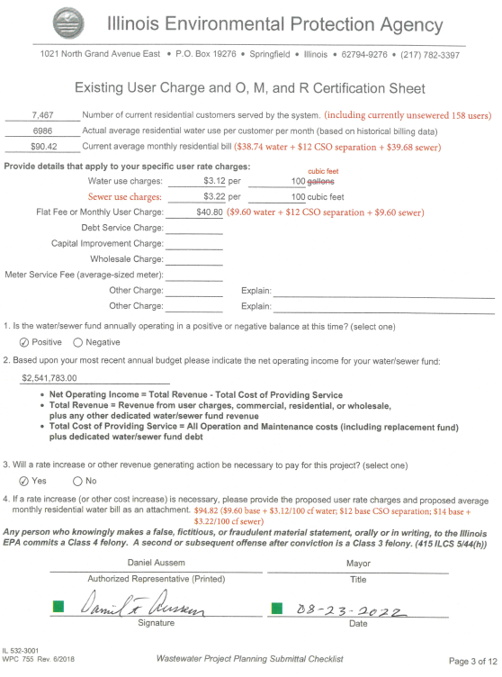
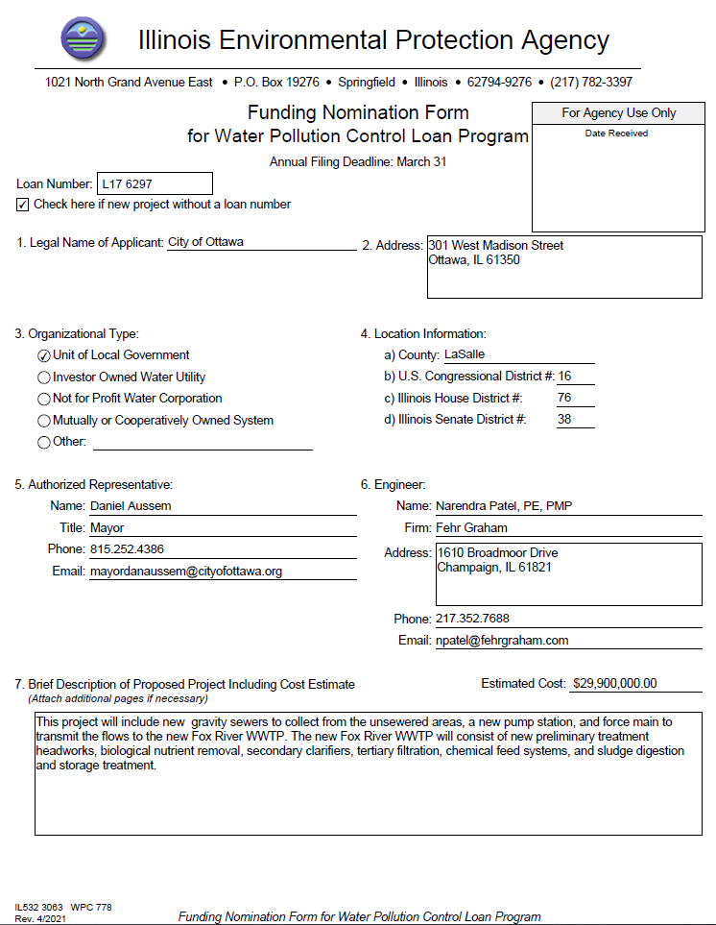
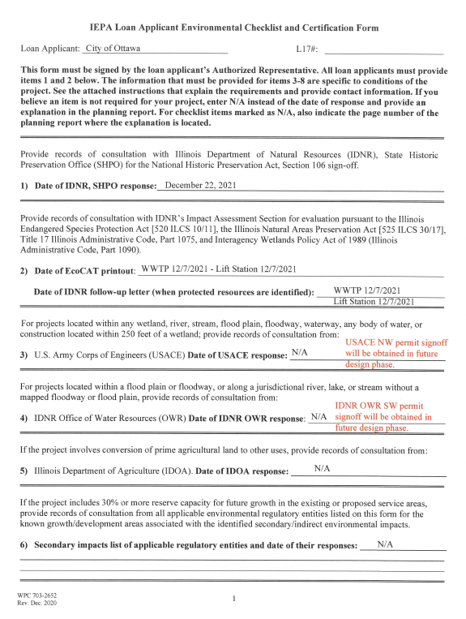
IEPA Facility Planning Report
IEPA Planning Submittal Forms/Checklists
IEPA Facility Planning Report

Slide 5
IEPA Facility Planning Highlights
General – Content listing
Executive summary
New Fox River WWTP – Plant design loading and IEPA effluent discharge limits
WWTP Alternatives
Alt #1 – New Fox River WWTP with pump station – Forcemain with discharge to Fox River
Alt #2 – Convert existing Illinois River WWTP to BNR facility with pump station – Forcemain with discharge to Illinois River
Alt #3 – “No Discharge” - New Fox River WWTP with pump station – Forcemain with effluent storage and spray irrigation
Alternatives present worth evaluation comparison
New Fox River WWTP, pump station, sewers and forcemain - Site aerial maps, WWTP process flow diagram, and preliminary cost estimate
IEPA Water Pollution Control Loan Program (WPCLP)’s low interest loan financing
Project implementation schedule
IEPA PEID approval summary
Refer to handouts for more details…

Slide 6
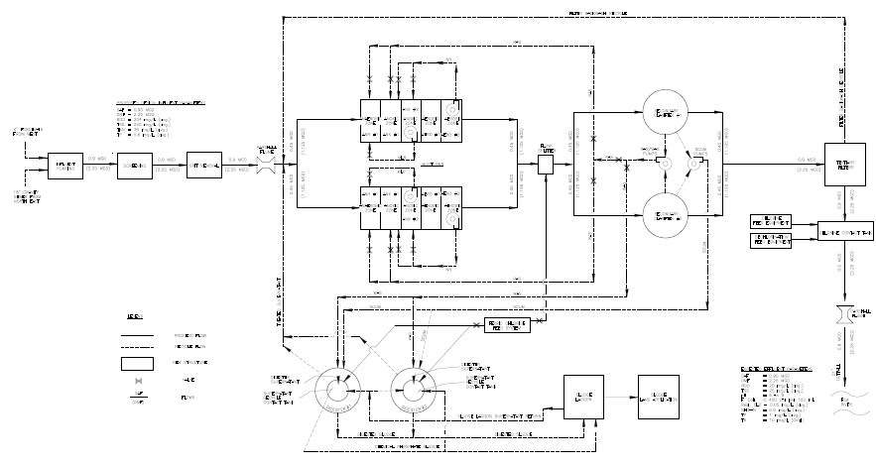
New Fox River WWTP Process Flow Diagram
Sanitary Pump Station, Sewers, and Forcemain
Secondary Biological / BNR Treatment
Tertiary Treatment
Preliminary Treatment
Sludge Treatment & Storage
New Outfall 001

Slide 7
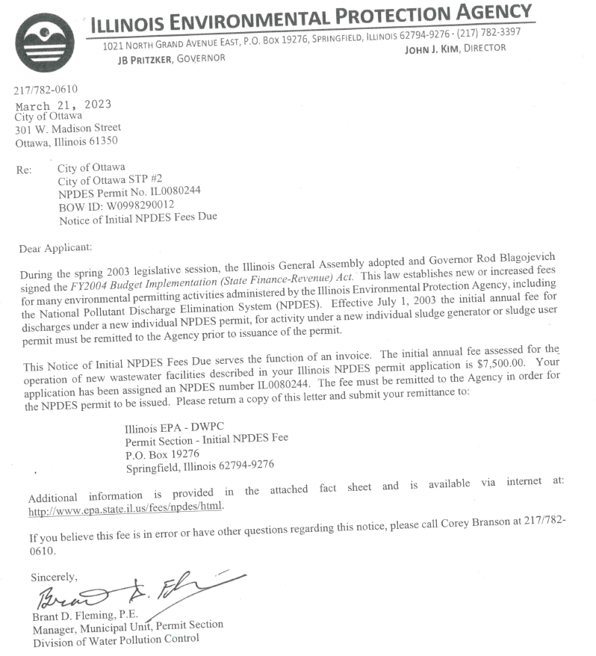
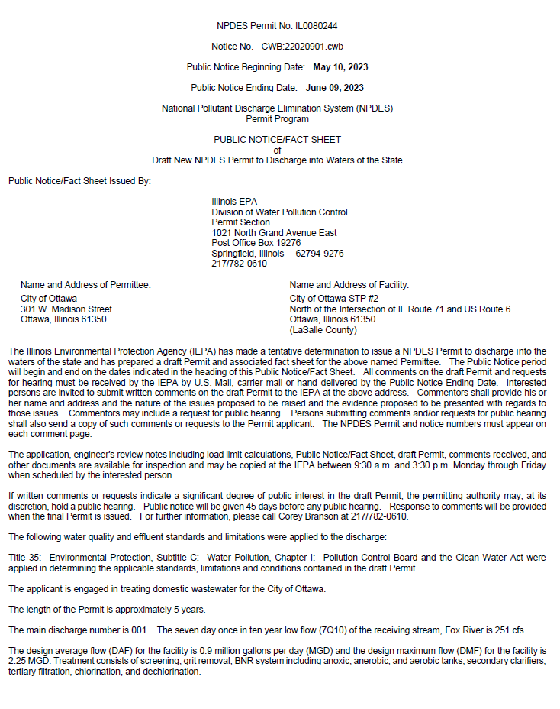
NPDES Permitting Highlights
NPDES Permit # IL0080244 (assigned)
Fox River Study Group engagement and project support
IEPA 10-day internal review draft of NPDES Permit
IEPA’s 30-day public notice public comment copy
Post 30-day comment period follow-up with IEPA
Final NPDES Permit status (pre-approved; on hold)…
NPDES Permit issuance towards end of upcoming design phase (for City to save annual NPDES Permit costs for now)
Refer to handouts for more details…

Slide 8
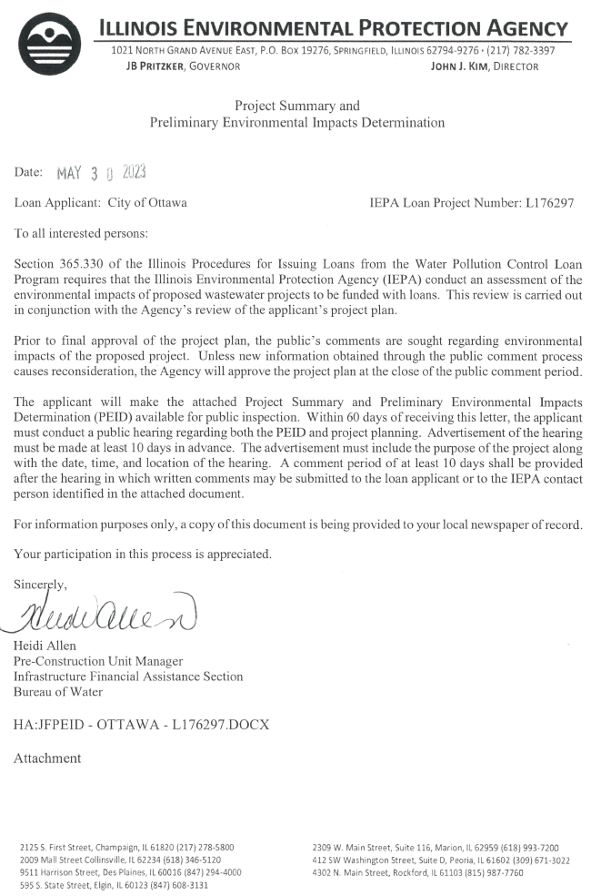
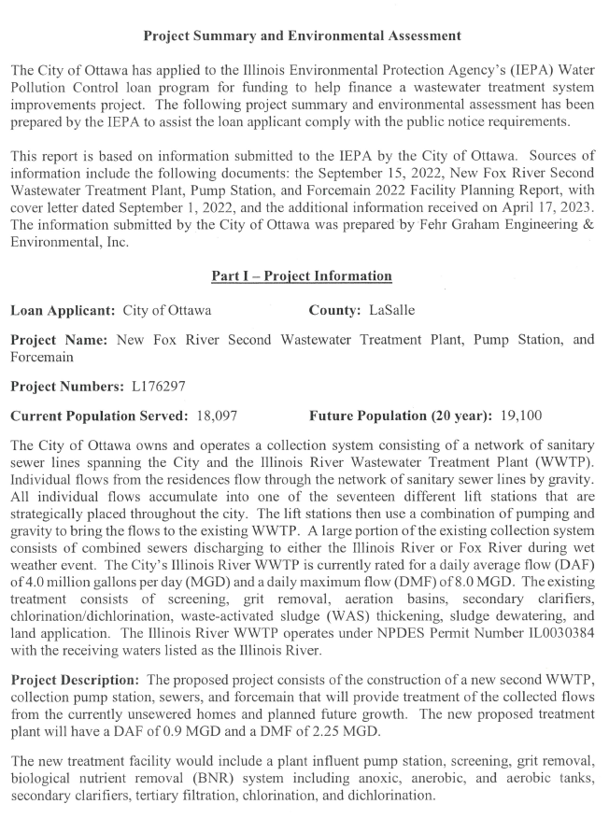
IEPA Facility Planning – PEID Approval
IEPA Loan Project # L17-6297 (assigned)
IEPA PEID issuance letter (May 30, 2023)
PEID project summary and environmental assessment
Project information, environmental impact, project affordability and financial impact
Comment period
Refer to handouts for more details…

Slide 9
Planned Schedule & Next Steps into Project
NPDES PERMIT APP AND ENGINEERING REPORT
CONSTRUCTION PHASE
DESIGN PHASE
May 2021 –
February 2022
July/August 2023 –
August 2025
December 2025 –
December 2029
IEPA FACILITY AND SRF LOAN PLANNING
BIDDING/
NEGOTIATING PHASE
May 2022 –
May 2023
August 2025 –
November 2025

Slide 10
Questions / Comments
Written comments may be submitted to:
Loan Applicant
Shelly Munks, City Clerk
City of Ottawa
301 W. Madison St.
Ottawa, IL 61350
IEPA Project Contact
Jillian Fowler, IFAS Project Manager
Illinois EPA, BOW
1021 N. Grand Avenue East
Springfield, IL 62794

